Slide 1
Various Designs of Chassis

Slide 2
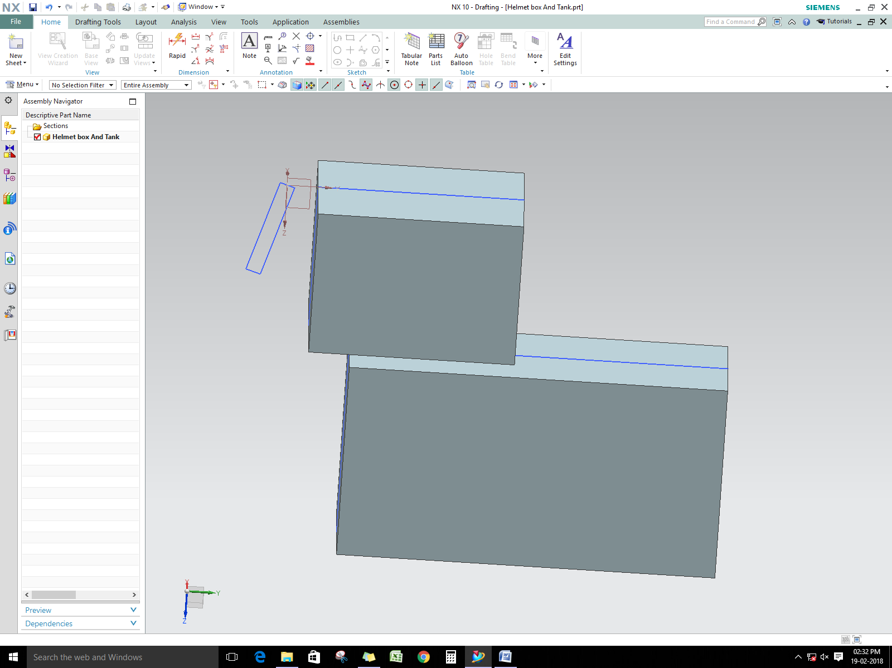

Slide 3
Design 1

Slide 4
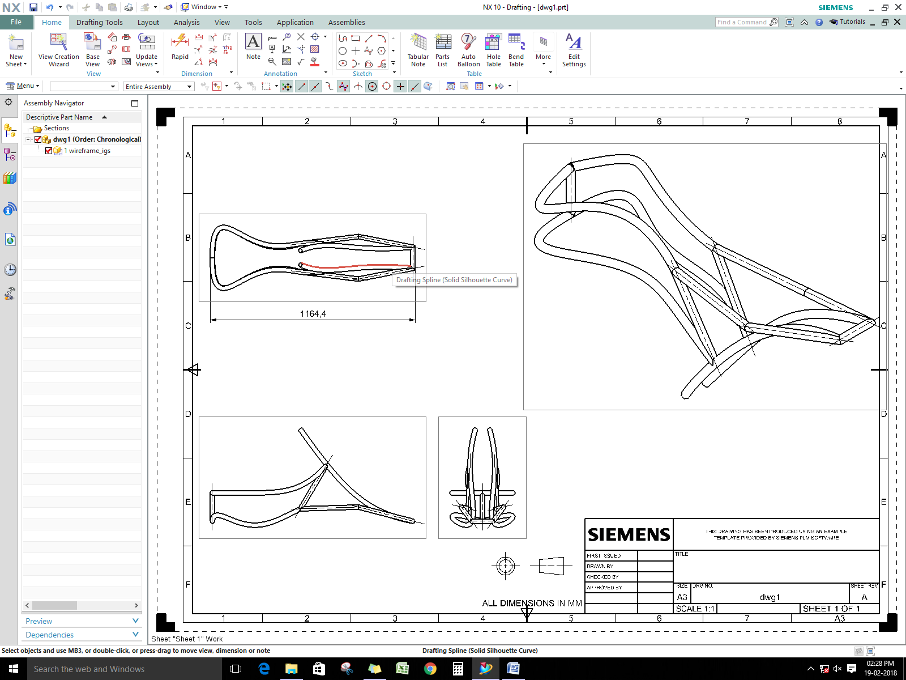

Slide 5
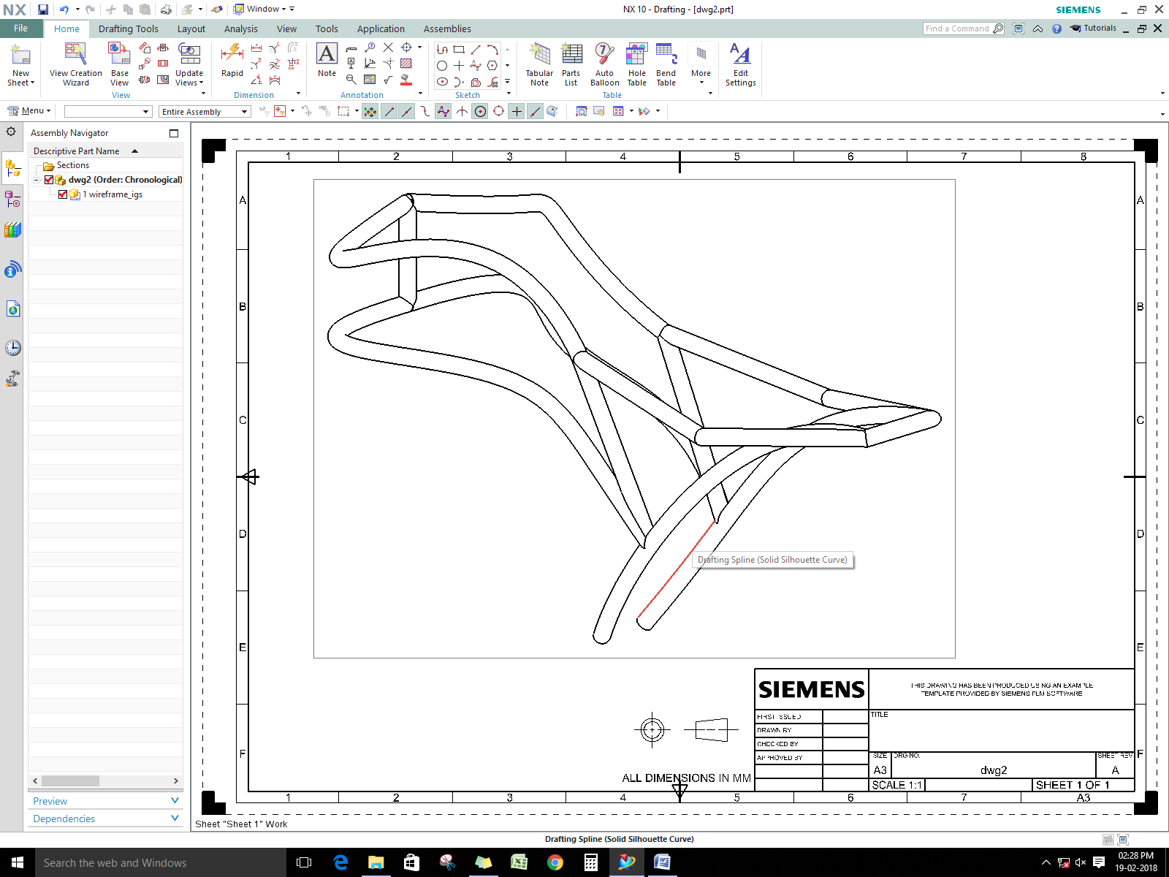

Slide 6
Design 2

Slide 7
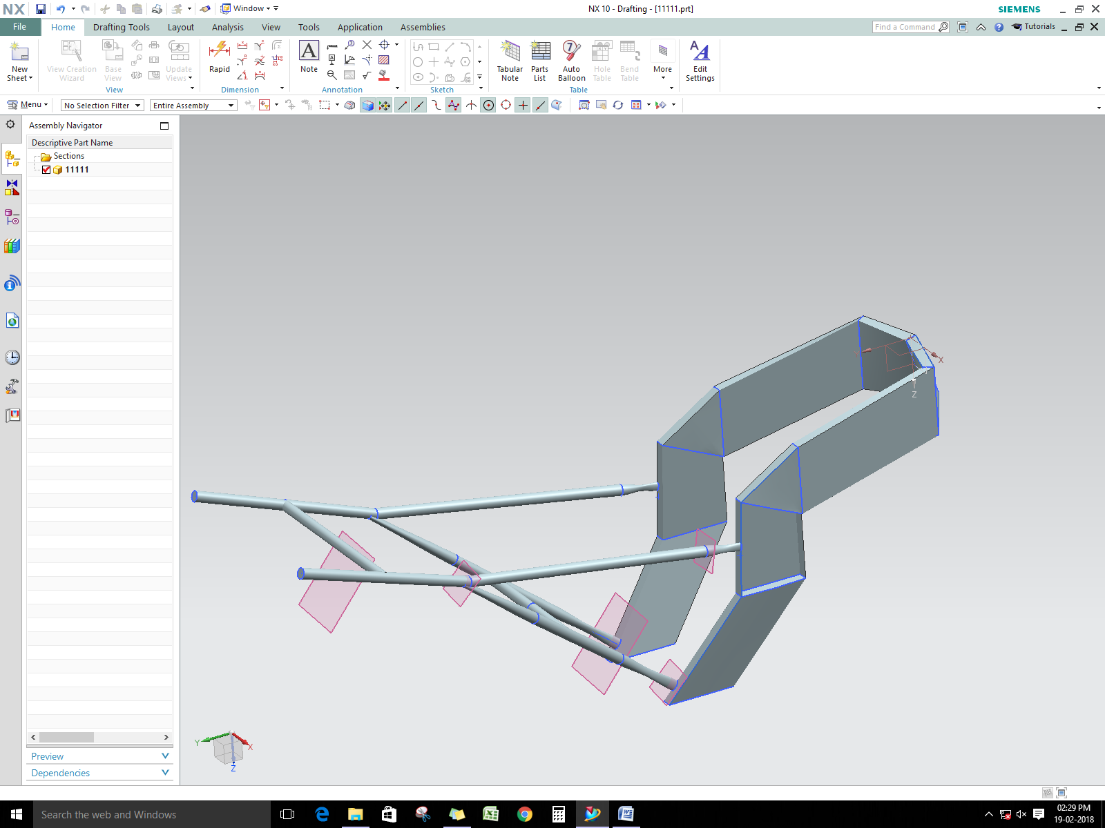

Slide 8
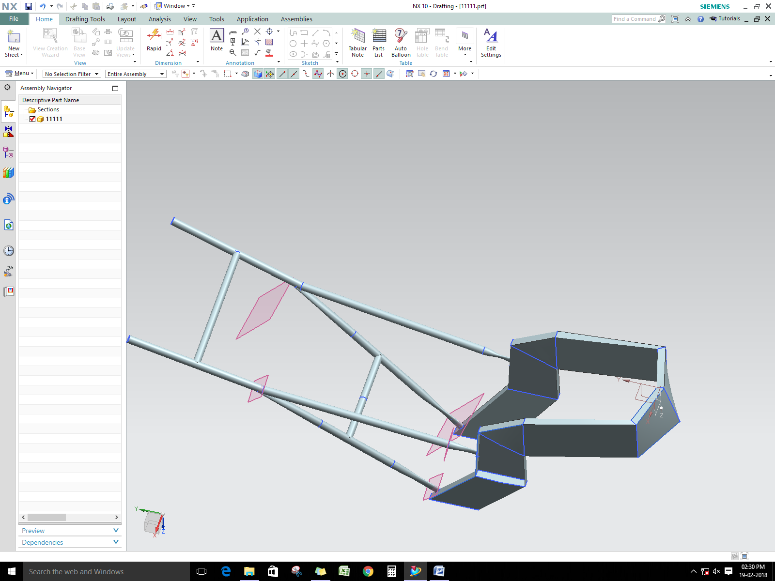

Slide 9
Design 3

Slide 10
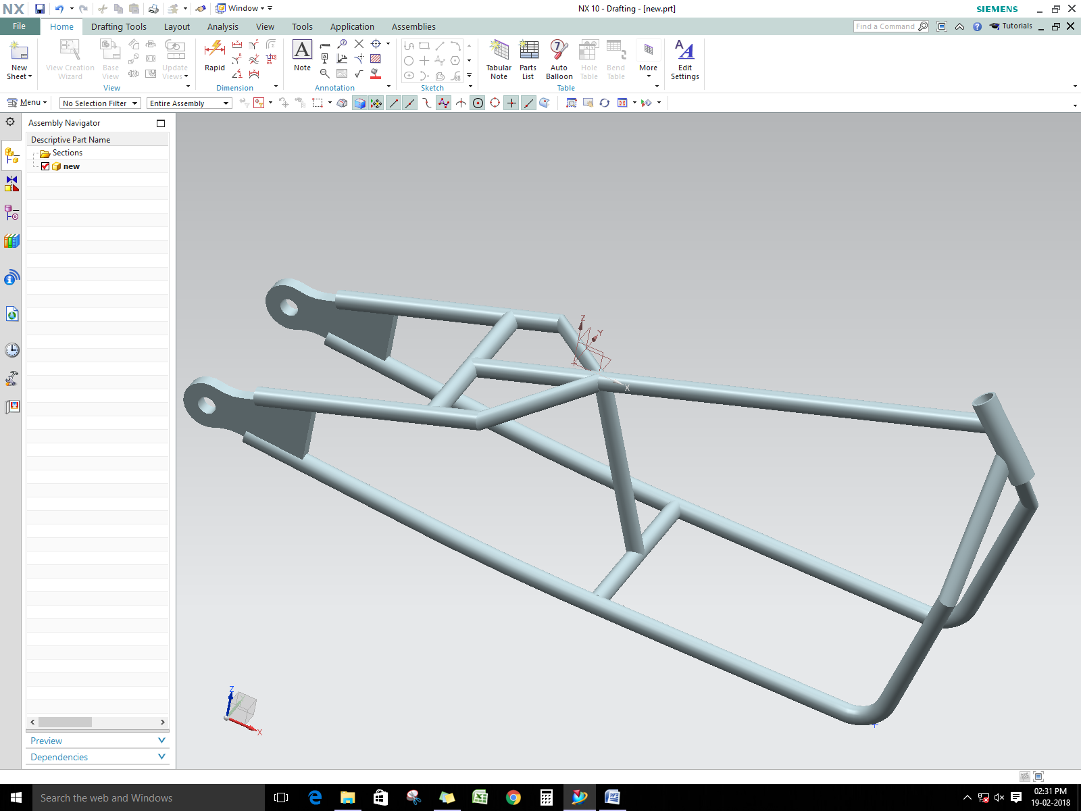

Slide 11
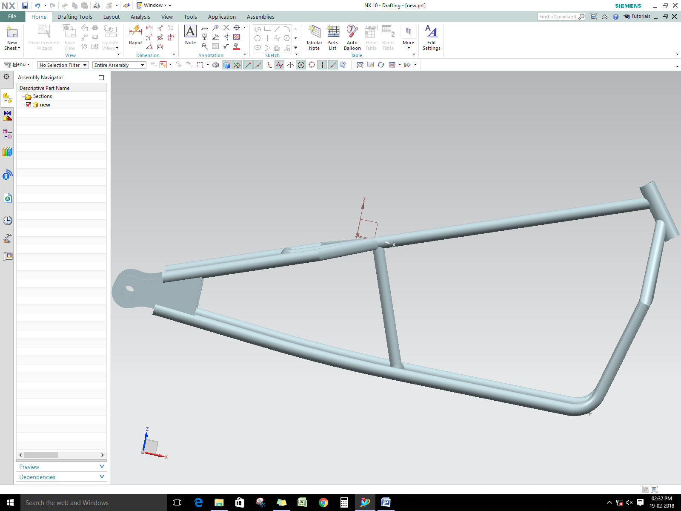

Slide 12
Design 4
Under Supervision

Slide 13
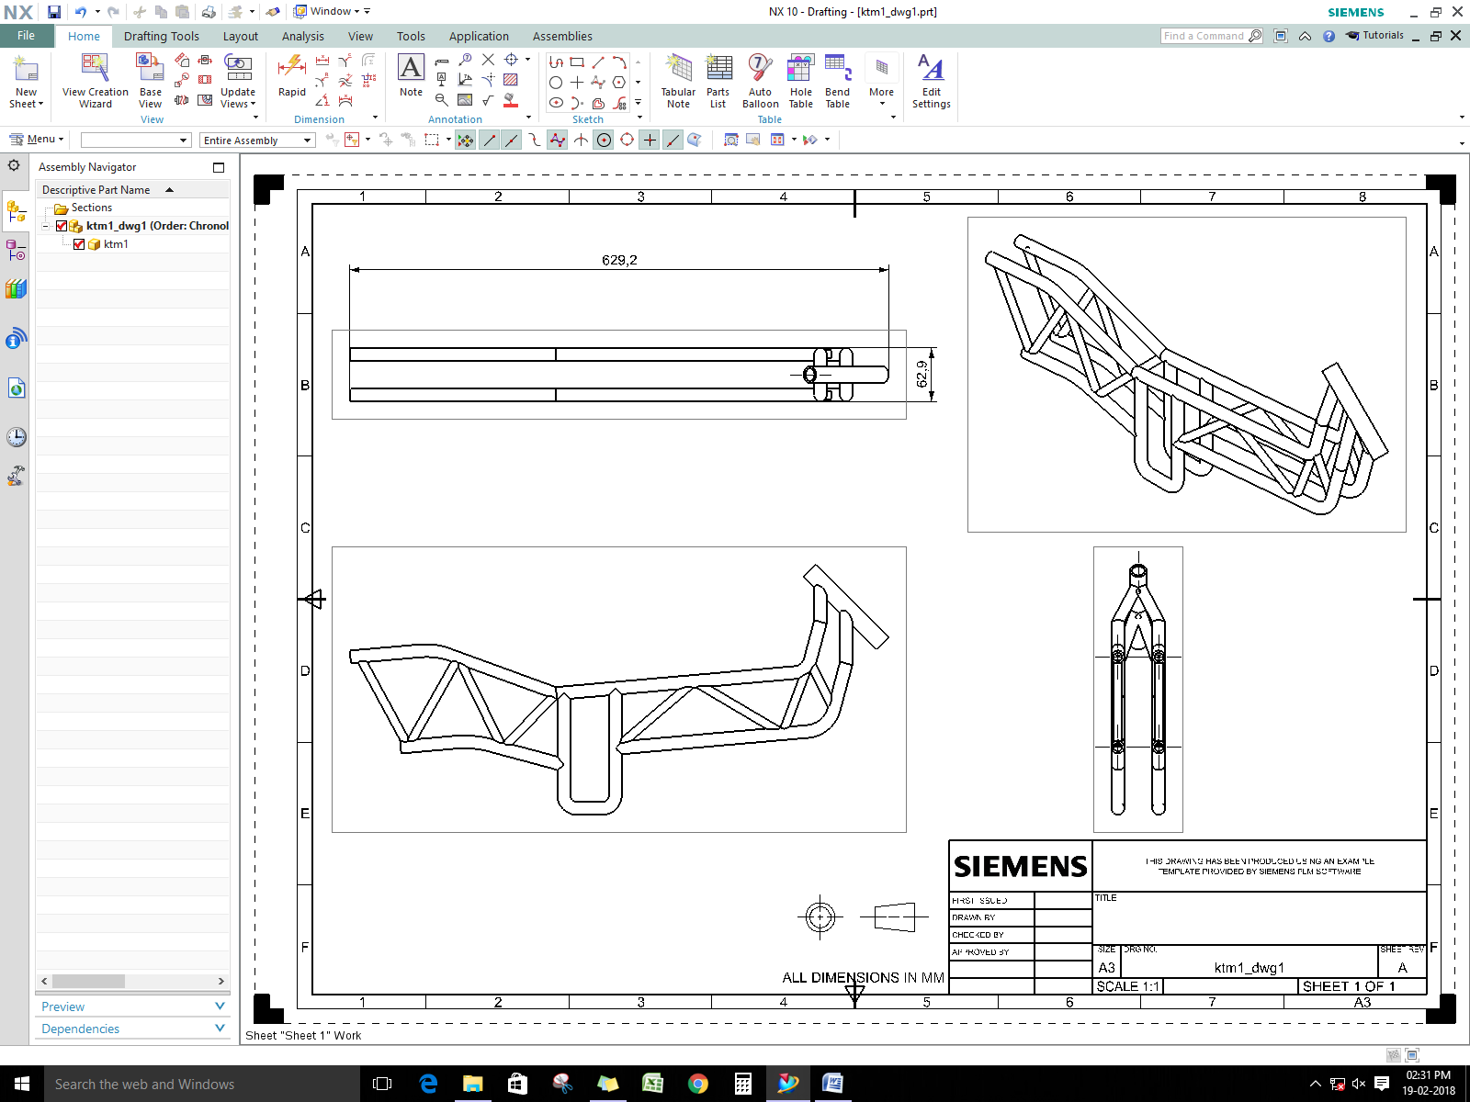

Slide 14
